Slide 1
CSE105 – Structured Programming
String

Slide 2
Fundamentals of Characters and Strings
Character constants: (which actually represents an integer value)
‘a’, ‘A’, ‘0’, ‘1’, ‘\n’, ‘ ’, ‘\0’, ..
String constants:
“I am a student”, “Your score %d\n”
Character variable to store a character
char c = ‘l’;
Character array, which can store a string
char str[15] = “I am a student”;

Slide 3
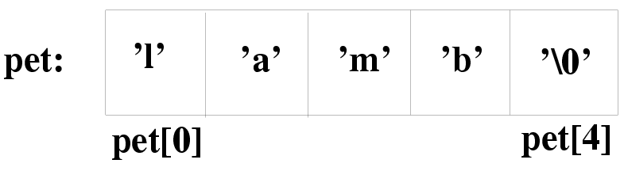
String Implementation and Representation
Implemented by an array of characters
  char pet[5] = {‘l’, ‘a’, ‘m’, ‘b’, ‘\0’};
  printf(“Mary has a little %s.\n”, pet);
  More accurate: NULL-terminated array of characters
Represented by a character array
      char color[] = "blue";

Slide 4
What is String
Strings are arrays of characters in which a special character—the null character (‘\0’)—marks the end.
The C library provides a collection of functions for working with strings.

Slide 5
String Literals
A string literal is a sequence of characters enclosed within double quotes:
"When you come to a fork in the road, take it."
String literals may contain escape sequences.
Character escapes often appear in printf and scanf format strings.
For example, each \n character in the string
"Candy\nIs dandy\nBut liquor\nIs quicker.\n --Ogden Nash\n"
causes the cursor to advance to the next line:
Candy
Is dandy
But liquor
Is quicker.
--Ogden Nash

Slide 6
Continuing a String Literal
The backslash character (\) can be used to continue a string literal from one line to the next:
printf("When you come to a fork in the road, take it. \
--Yogi Berra");
In general, the \ character can be used to join two or more lines of a program into a single line.

Slide 7
How String Literals Are Stored
When a C compiler encounters a string literal of length n in a program, it sets aside n + 1 bytes of memory for the string.
This memory will contain the characters in the string, plus one extra character—the null character—to mark the end of the string.
The null character is a byte whose bits are all zero, so it’s represented by the \0 escape sequence.

Slide 8
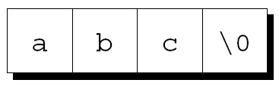

How String Literals Are Stored
The string literal "abc" is stored as an array of four characters:
The string "" is stored as a single null character:

Slide 9
String Literals versus Character Constants
A string literal containing a single character isn’t the same as a character constant.
  "a" is represented by a pointer.
  'a' is represented by an integer.
A legal call of printf:
printf("\n");
An illegal call:
printf('\n'); /*** WRONG ***/

Slide 10
String Variables
Any one-dimensional array of characters can be used to store a string.
A string must be terminated by a null character.

Slide 11
String Variables
If a string variable needs to hold 80 characters, it must be declared to have length 81:
char str[80+1];
Adding 1 to the desired length allows room for the null character at the end of the string.
Failing to do so may cause unpredictable results when the program is executed.

Slide 12
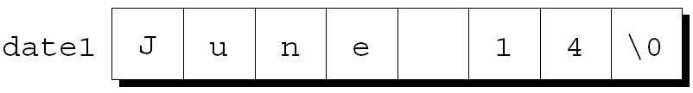
Initializing a String Variable
A string variable can be initialized at the same time it’s declared:
char date1[8] = "June 14";
The compiler will automatically add a null character so that date1 can be used as a string:

Slide 13
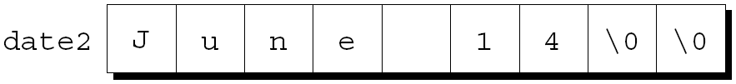
Initializing a String Variable
If the initializer is too short to fill the string variable, the compiler adds extra null characters:
char date2[9] = "June 14";
Appearance of date2:

Slide 14
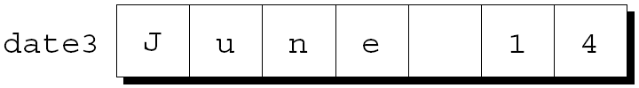
Initializing a String Variable
An initializer for a string variable can’t be longer than the variable, but it can be the same length:
char date3[7] = "June 14";
There’s no room for the null character, so the compiler makes no attempt to store one:

Slide 15
Initializing a String Variable
The declaration of a string variable may omit its length, in which case the compiler computes it:
char date4[] = "June 14";
The compiler sets aside eight characters for date4, enough to store the characters in "June 14" plus a null character.
Omitting the length of a string variable is especially useful if the initializer is long, since computing the length by hand is error-prone.

Slide 16
Reading and Writing Strings
Writing a string is easy using either printf or puts.
To read a string in a single step, we can use either scanf or gets.
As an alternative, we can read strings one character at a time.

Slide 17
Writing Strings Using printf and puts
The %s conversion specification allows printf to write a string:
char str[] = "Are we having fun yet?";
printf("%s\n", str);
The output will be
Are we having fun yet?
printf writes the characters in a string one by one until it encounters a null character.

Slide 18
Writing Strings Using printf and puts
printf isn’t the only function that can write strings.
The C library also provides puts:
puts(str);
After writing a string, puts always writes an additional new-line character.

Slide 19
Reading Strings Using scanf and gets
The %s conversion specification allows scanf to read a string into a character array:
scanf("%s", str);
str is treated as a pointer, so there’s no need to put the & operator in front of str.
When scanf is called, it skips white space, then reads characters and stores them in str until it encounters a white-space character.
scanf always stores a null character at the end of the string.

Slide 20
Reading Strings Using scanf and gets
scanf won’t usually read a full line of input.
A new-line character will cause scanf to stop reading, but so will a space or tab character.
To read an entire line of input, we can use gets.
Properties of gets:
  Doesn’t skip white space before starting to read input.
  Reads until it finds a new-line character.
  Discards the new-line character instead of storing it; the null character takes its place.

Slide 21
Reading Strings Using scanf and gets
Consider the following program fragment:
char sentence[80+1];
printf("Enter a sentence:\n");
scanf("%s", sentence);
Suppose that after the prompt
Enter a sentence:
the user enters the line
To C, or not to C: that is the question.
scanf will store the string "To" in sentence.

Slide 22
Reading Strings Using scanf and gets
Suppose that we replace scanf by gets:
gets(sentence);
When the user enters the same input as before, gets will store the string
" To C, or not to C: that is the question."
in sentence.

Slide 23
Reading Strings Character by Character
Suppose we need a function that (1) doesn’t skip white-space characters, (2) stops reading at the first new-line character (which isn’t stored in the string), and (3) discards extra characters.
A prototype for the function:
int read_line(char str[], int n);
If the input line contains more than n characters, read_line will discard the additional characters.
read_line will return the number of characters it stores in str.

Slide 24
Reading Strings Character by Character
read_line consists primarily of a loop that calls getchar to read a character and then stores the character in str, provided that there’s room left:
int read_line(char str[], int n)
{
int i = 0;
char ch;
while ((ch = getchar()) != '\n')
if (i < n)
str[i++] = ch;
str[i] = '\0'; /* terminates string */
return i; /* number of characters stored */
}

Slide 25
Reading Strings Character by Character
Before returning, read_line puts a null character at the end of the string.
Standard functions such as scanf and gets automatically put a null character at the end of an input string.
If we’re writing our own input function, we must take on that responsibility.

Slide 26
Accessing the Characters in a String
Since strings are stored as arrays, we can use subscripting to access the characters in a string.
To process every character in a string s, we can set up a loop that increments a counter i and selects characters via the expression s[i].

Slide 27
Accessing the Characters in a String
A function that counts the number of spaces in a string:
int count_spaces()
{
char s[1000];
int count = 0, i;
gets(s);
for (i = 0; s[i] != '\0'; i++)
if (s[i] == ' ')
count++;
return count;
}

